Slide 1


Literature Review
Explain the reasons for conducting a literature review to justify its use.
Organise a literature review consistent with a quantitative, qualitative, or mixed‑methods approach.
Describe the steps typically taken when carrying out a literature review.Identify the types of terms that need to be defined in an academic research report.

Slide 2
2/24/2026
Steps in the process of developing a research proposal
The topic (of the research) is the subject or matter proposed for study. It is the central idea to learn about or explore in a study.
Title
Significance
Object of review
¿Should the problem be studied?
¿Can de problem be studied?
Availability of data
Availability of resources
Detailed examination of the research topic.
Data analysis

Slide 3
2/24/2026
Steps in the process of developing a research proposal
Should the topic be studied?
This is the case when the topic contributes to the body of research knowledge in the available literature.
1.
Replicate previous studies
How does this project contribute to the literature?
2.
Give voice to underrepresented groups or individuals
3.
Address social justice or transform researchers’ ideas and beliefs
Data analysis

Slide 4
2/24/2026
Steps in the process of developing a research proposal
Should the topic be studied?
How does this project contribute to the literature?
This is the case when the topic contributes to the body of research knowledge in the available literature.
1.
Replicate previous studies
🌏 Studying an unusual location
🧑🏻‍🦽‍➡️ Examining a new/unusual group of participants
👓 Taking an unexpected perspective that challenges expectations in the field
📊 Providing novel means of data collection
📈 Presenting results in new ways
⌛ Studying a timely or current issue
2.
Give voice to underrepresented groups or individuals
3.
Address social justice or transform researchers’ ideas and beliefs
Data analysis

Slide 5
Purpose of a Literature Review
1.
Share with the reader the results of other studies that are closely related to the topic being investigated.
Broad review of the problem
2.
Relate the study to the existing literature, filling gaps and expanding on previous studies.
Focused problematization
3.
Provide a framework to establish the importance of the study and a point of reference to compare the results with other findings.

Slide 6
Purpose of a Literature Review
A literature review means locating and summarizing studies on a topic
These are often research studies, but they may also include:
Conceptual articles
Opinion pieces that provide frameworks for thinking about the
There is no single way to conduct a literature review, but in academia the process is carried out systematically to capture, evaluate, and summarize the literature.
Organization
Steps
1
2

Slide 7
2/24/2026
Organization of the Literature Review
General Forms
From a general perspective, the literature review consists of information that supplements the introduction of the study. Alternatively, it may have its own section within the document.”
Qualitative Structure
The literature is used to learn from participants without imposing questions from the researcher’s perspective. Qualitative studies are exploratory; there is usually little prior research on the topic or population, so the focus is on listening to and understanding participants.
Quantitative Structure
It serves to introduce the problem, detail the existing literature, and present theories that explain expected relationships, justifying their relevance to the study, as well as to support the study’s hypotheses.
Mixed‑Methods Structure
The researcher adopts a qualitative or quantitative approach to the literature depending on the strategy employed. For example, in sequential approaches, the literature is presented in each phase according to the method applied in that stage.
Data analysis

Slide 8
2/24/2026
Organization of the Literature Review
General Forms
From a general perspective, the literature review consists of information that supplements the introduction of the study. Alternatively, it may have its own section within the document.
1.
Integrating methods and findings from other studies
3.
Connecting themes or areas
2.
Critiquing methods and findings from other studies
4.
Identifying a central problem within the field of knowledge
Data analysis

Slide 9

2/24/2026
Organization of the Literature Review
Qualitative Structure
Qualitative studies are exploratory; there is usually little prior literature on the topic or population, so the focus is on listening to and understanding participants.
Use of the Literature | Criteria | Examples
Framing the problem in the introduction of the study | There must be some literature available | Used in all types of qualitative studies
Different section from the introduction | Post‑positivist traditional approach to literature reviews | Studies with a quantitative approach
Presented at the end of the document to compare the study’s findings | Does not guide or direct the study. It supports the work after identifying patterns or categories | Studies with a qualitative approach
Inductive
Approach
Data analysis

Slide 10

2/24/2026
Organization of the Literature Review
Quantitative Structure
Use in the introduction
Developed at the beginning of the study to provide direction for the research questions and hypotheses.
Step | Contents
Introduction | Description of the contents of the review (subsections).
Dependent Variable | Review of studies related to the dependent variable.
Independent Variable | Review of studies related to the independent variable (with subsections if there are multiple ones).
Variable Relationships | This section should be relatively short and contain studies that are extremely related to the proposed study topic.
Summary | Presents the most important studies and suggests the reason for investigating the topic and how the research seeks to contribute to that need.
Use in a separate section
Developed at the beginning of the study to provide direction for the research questions and hypotheses.
Use at the end
Comparison of the study’s results with the findings of the existing literature.
Deductive
Approach
Data analysis

Slide 11
2/24/2026
Organization of the Literature Review
Mixed-methods Structure
A qualitative or quantitative approach to the literature is used depending on the type of strategy employed.
Quantitative start: include a review that helps establish justification for the research questions or hypotheses.
In a sequential approach, the literature is presented in each phase according to the method used. The literature used must be consistent with the primary design type and with the most prevalent qualitative or quantitative approach in the design.
Qualitative start: the literature is substantially reduced, incorporate it at the end of the study, adopting an inductive approach.
Inductive
Deductive
Approach
Approach
Data analysis

Slide 12
2/24/2026
(Suggested ) steps for a literature review
Planning the review
1.
Formulate the problem
2.
Develop and validate the review protocol
Conducting the review
3.
Search the literature
Review titles
4.
Review abstracts
Screen for inclusion
5.
Review full text
Assess quality
6.
Extract data
7.
Synthesize data
Report findings
8.
Report findings

Slide 13
2/24/2026
(Suggested ) steps for a literature review
Keywords search in data bases
Protocol
Sources
50
Prioritization of articles
Literature map
Summaries of Relevant Articles
Identification of Keywords
Synthesis
Step 8 Structured literature review
Step 1
Steps 2 and 3
Steps 4 and 5
Step 6
Step 7
Identify keywords to locate materials in a database.
These keywords may arise from defining a topic or from preliminary readings.
Search for Keywords in databases such as ERIC, Google Scholar, Web of Science, EBSCO, ProQuest, and JSTOR.
Locate 50 relevant articles that are accessible.
Review the articles and collect those that are central to your topic.
Determine whether each article will make a meaningful contribution to your understanding of the literature.
A literature map provides a visual image of clusters of literature on the topic, showing how your particular study will contribute, expand, or replicate existing research.
Combine these summaries in the final literature review that you prepare for your research proposal or study. Include accurate references.
Assemble the literature review, structuring it thematically or organizing it according to important concepts.

Slide 14
2/24/2026
Step 1
Review protocol
The review protocol is comparable to a research design in social science studies
It is a preset plan that specifies the methods utilized in conducting the review
It reduces the possibility of research bias in data selection and analysis .
It increases the reliability of the review because others can use the same protocol cross-check and verification.
The purpose of the study
Research questions
Inclusion criteria
Search strategies
Quality assessment criteria and screening procedures
Strategies for data extraction, synthesis, and reporting
Data analysis

Slide 15







2/24/2026
Steps 2 and 3
Literature Search
Use both the free online literature databases and those available through Externado’s online resources.
1.
Use term guides to locate your articles, such as a thesaurus, when available.
2.
Conduct a preliminary search using online thesaurus descriptors and by locating a journal article or document on a topic.
3.
Then look closely at the descriptors used in this article and document and perform another search using those terms.
Data analysis

Slide 16





2/24/2026
Steps 2 and 3
Literature Search
Backward and forward search by author or document
When searching for the publications of key authors who contribute to the body of work, it is possible to identify relevant studies.
A search through the authors’ CVs, Google Scholar pages, and publications listed in researcher networks such as ResearchGate.net are good ways to locate their other publications.
You can also identify cross‑references in relevant works for each area by using seed‑based search tools.
Data analysis

Slide 17
2/24/2026
Steps 4 and 5
Articles prioritization and evaluation
1.
What types of literature should be reviewed, and in what order of priority?
If the topic is unfamiliar: broad literature syntheses, such as encyclopedia entries, meta-analyses, reviews, or series of summaries.
Relevance of journals and scientific publications: review the most recent journal issues and then work backward. Follow the references at the end of the articles to locate more sources.
Review of books and book chapters.
Review of conference papers and presentations.
2.
Quality evaluation
Journals: look for articles published in peer‑reviewed journals. These are journals with an editorial board.
Books: look for publishers with recognized names and years of service.
Conference papers: they may provide useful and high‑quality information if the work is included as a presentation in a recent conference.
Data analysis

Slide 18
2/24/2026
Steps 4 and 5
Articles prioritization and evaluation
Identification
1.
Records defined through data base searching (n = 97)
Screening
2.
Records after duplicates removed (n = 92)
Records excluded (n = 28)
Conference proceeding (n = 9)
No guidance on review (n=4)
Irrelevant methodology to design (n=15)
3.
Records screened (n = 92)
Full articles excluded (n =18)
Conference proceeding (n = 9)
No guidance on review (n=4)
Irrelevant methodology to design (n=15)
Eligibility
4.
Full text articles assessed for eligibility (n = 64)
Inclusion
5.
Studies included (n = 46)
Additional record identified – forward and backward searches (n = 17)
6.
Total number of studies included (n = 99)
Additional methods and example papers (n = 37)

Slide 19
2/24/2026
Steps 6
Literature map
A literature map enables researchers to organise the literature review.
It helps researchers understand how the proposed study adds to, expands upon, or replicates existing research.
In positivistic approaches it helps to map theoretical relationships between constructs.
1.
Hierarchical
2.
Flow-based
3.
Set-based
Presenting the literature from the top down, ending with the proposed study at the bottom.
Understands the literature from left to right, with the far-right section advancing towards a proposed study.
Circles represent a body of literature, and the intersection of circles indicates areas where further research is needed.
Data analysis

Slide 20
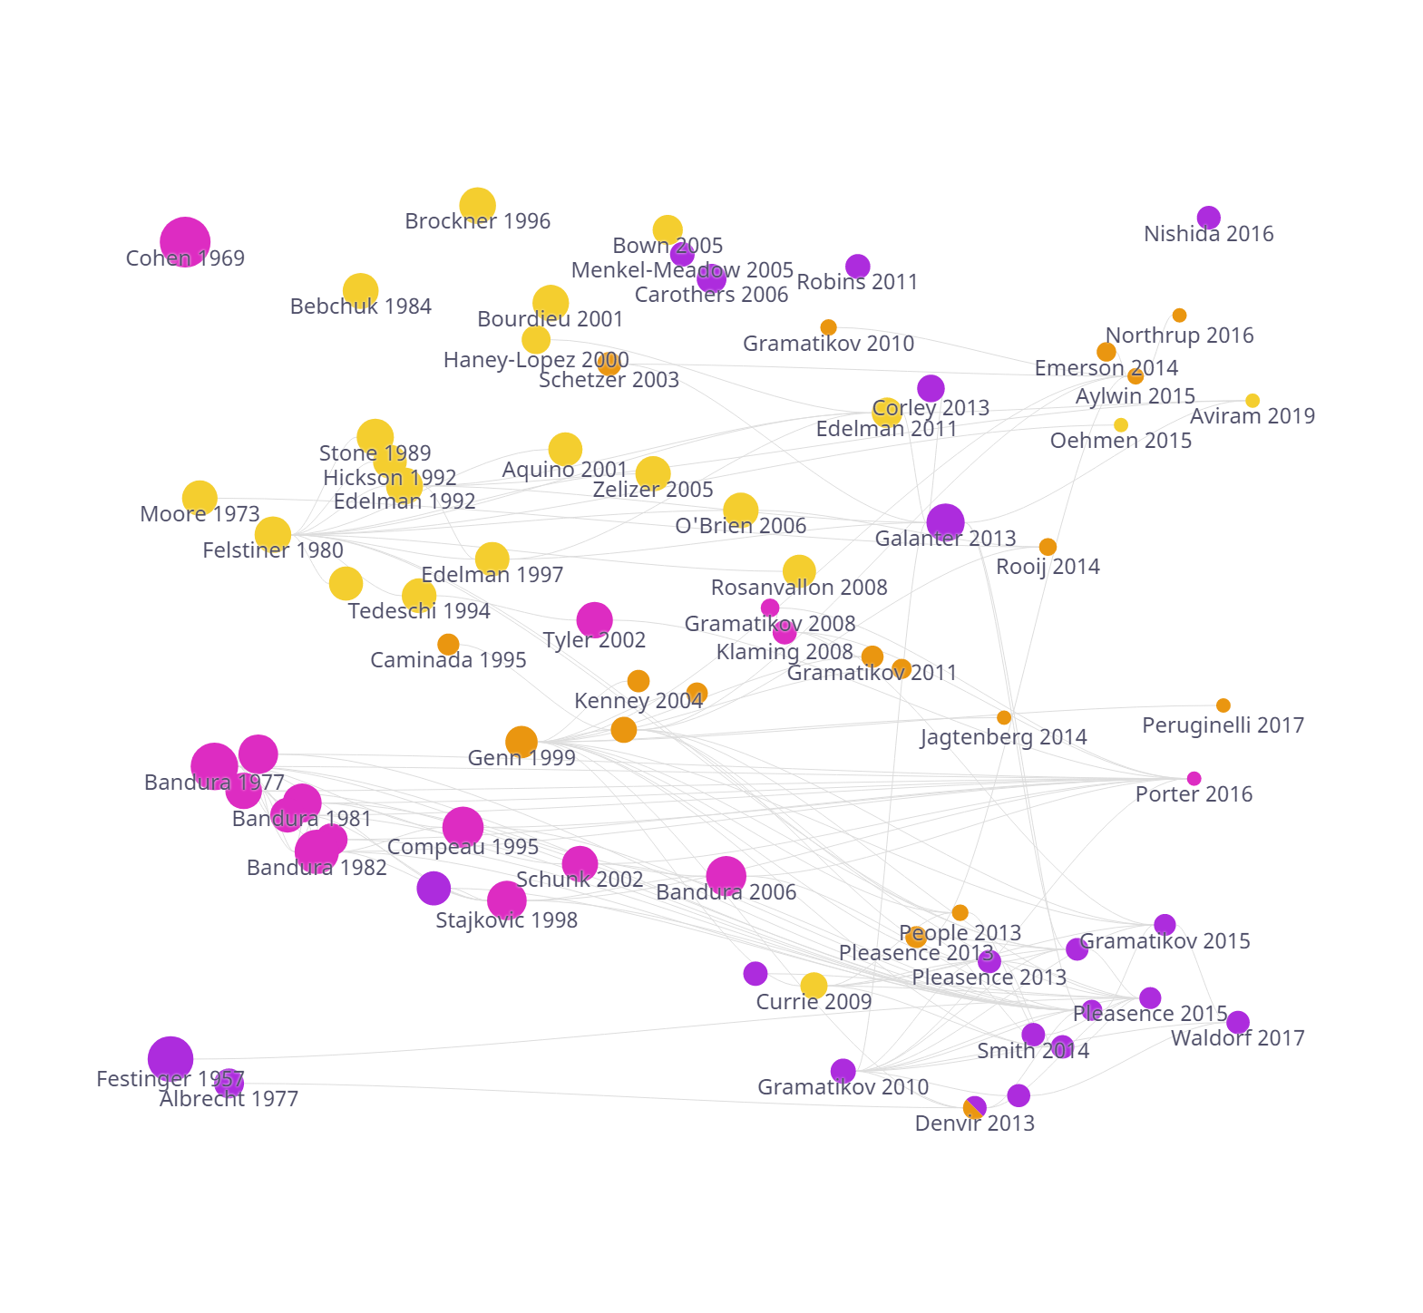
2/24/2026
2/24/2026
2/24/2026
Steps 6
Literature map Set based example
Legal capability and barriers sub-network community
Recent literature on access to justice brings together two main perspectives.
The first focuses on identifying legal needs through person‑centred accounts, typically using large‑scale household surveys.
The second centres on legal capability, understood as a fundamental attribute that shapes individuals’ ability to engage effectively with the justice system.
🟡Self-efficacy literature 🟣People centered access to justice literature 🟠 Legal capability and barriers literature 🟠 Surveys and methods literature
Self-efficacy sub-network community
People-centered access to justice and surveys sub-network community
Data analysis

Slide 21
2/24/2026
2/24/2026
2/24/2026
Steps 6
Literature map Hierarchical example
Procurement justice in organizations
Shaping of justice perceptions
Impacts of justice
Justice and organizational change
Motives Tyler,1994
Knowledge Tyler,1994
Results Tayler, 2000
Trust Pugh,1994
Reasons
Des-invest Becker, 2000
History Angle, 1998
Environments Bennet,2000
Structures Bennet,2000
Behavior Moorman,1994
Support Moorman, 1998
Reallocation Daly, 1995
Leadership Moorman, 1998
Agency Shapiro, 1998
Hutton, 1998
Unjust treatment Dailey, 1992
Tepper, 2000
Postponements May, 1998
Strategies Kim, 1998
Why study procurement justice in organizations?
Data analysis

Slide 22


Use of theory
The scientific method
Dr Evelyn Behar and Dr Nicole Cain discuss the steps involved in planning and conducting research.
The steps of the scientific method help to strengthen the research process and enhance the researcher’s ability to draw sound conclusions from it.
Behar and Cain address the selection of a research topic, the design of a study, and the procedures required to carry out the research.

